Slide 1
Presentation on Human Resource Analysis
Name: Mohd Areeb Ansari
Last Update: 20th July 2025

Slide 2
Agenda
Introduction
Objective
Data Gathering
Insights
Conclusion

Slide 3
Objective
Human resource analysis involves examining various aspects of an organization’s workforce to gain insights into its effectiveness, productivity, and overall performance.
So, in this, we are mainly focusing on the following points:
To find out the reason or exit cause of employees at different office locations.
Check the performance rating of the individual designation in the company.
What are the effective recruitment sources or platforms used to hire a good candidate?
Evaluate the candidate's needs on a future, urgent, or immediate basis.

Slide 4
Data Gathering
The data has been acquired from online source in excel format.
After that I cleaned the data, check the format and remove null values from it and also check the data type is it in correct form or not.
Then I load the data in power bi and started creating visualization.
Raw Data Link: ..\..\..\Downloads\HR DATA DASHBOARD.xlsx

Slide 5
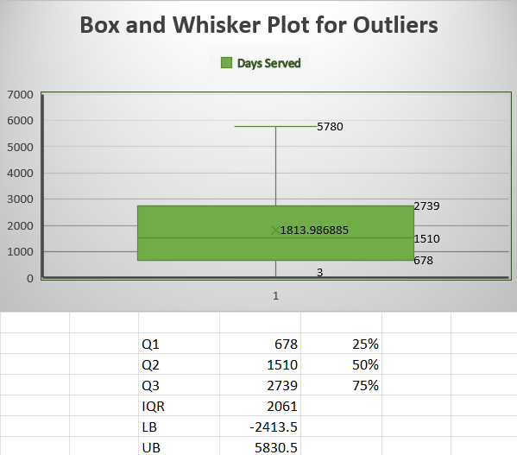
Insights: Finding Outliers
An outlier is a data point that goes far outside the average value of a group of statistics.
In this data, IQR has been performed along with a box and whiskers chart to detect outliers, to check if there’s a value that stands out from the rest of the data, for example, negative values or a high value.

Slide 6
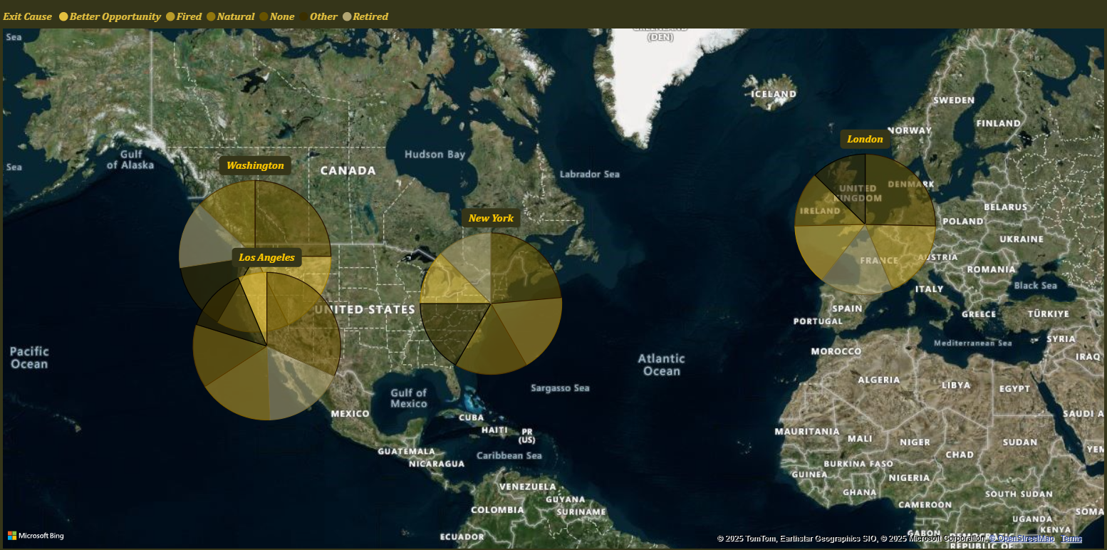
Insights: To Find Out The Reason Or Exit Cause Of Employees Of Different Office Locations.
The Washington office has the maximum number of employees who have exited.
The London office has the minimum number of employees who have exited.

Slide 7
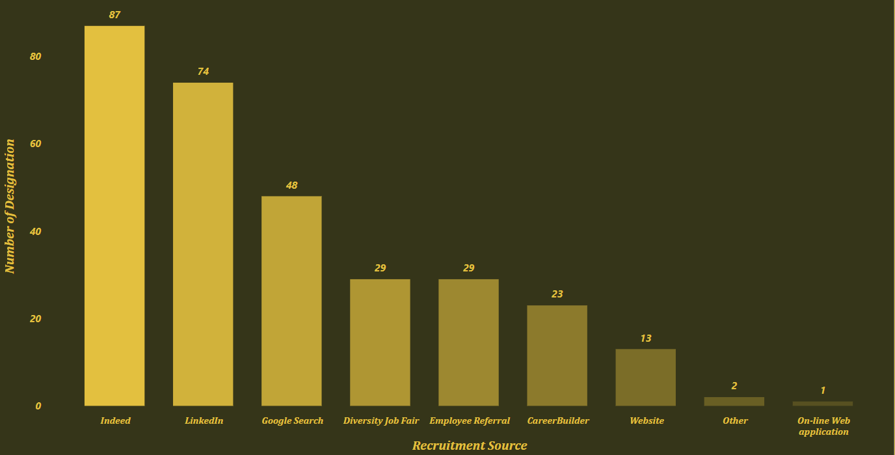
Insights: What Are The Effective Recruitment Sources Or Platforms Used To Hire Good Candidates?
In this, we can see that from Indeed, we have found a good number of candidates, and their performance was also good.
So, in the future, we will be mainly focusing on Indeed for hiring and sourcing the good and experienced candidates.

Slide 8
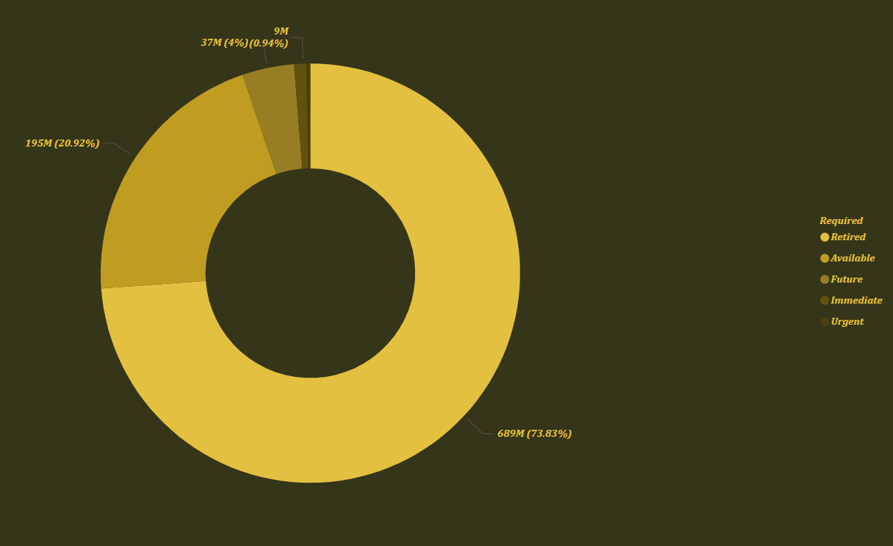
Insights: Check The Need Of Candidates For Future, Urgent, Or Immediate Basis.
Using a pie chart, we can easily visualize the various requirements of employees for the future, whether they are urgent or immediate. Additionally, we can update the file based on these needs, and the results will automatically reflect any changes made.

Slide 9
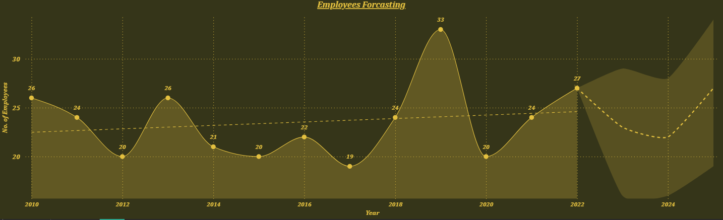
Insights: Forecast The Number Of Candidates or Employees Needed For The 2 Consecutive Years.
The forecast predicts a slight decline in employee numbers in 2023 and 2024.
2023: Approx. 22 employees expected.
2024: Number remains relatively stable around 22–23, with a slight upward confidence band, indicating potential for increase.
HR and recruitment teams should plan for moderate hiring in 2023–24 while preparing for a possible increase post-2024.
Consider maintaining a flexible workforce to adapt to these fluctuations.

Slide 10
Conclusion
Identifying Employee Exit Causes: By analyzing the reasons for employee exits across different office locations, patterns or common factors may emerge. This could lead to targeted interventions or adjustments in management practices to mitigate turnover.
Performance Rating Analysis: Assessing performance ratings across various designations within the company can help identify areas of strength and areas needing improvement. It could inform training programs, mentorship initiatives, or restructuring efforts to optimize employee performance.
Effective Recruitment Sources: By evaluating the success rates of different recruitment platforms or sources, the company can allocate resources more effectively towards those yielding the highest quality candidates. This could involve investing more in successful platforms or exploring new ones to diversify talent pools.
Future Candidate Needs: Understanding the company's future, urgent, or immediate hiring needs for two consecutive years can inform strategic workforce planning. It allows for proactive recruitment efforts, talent pipeline development, and succession planning to ensure the organization has the right people in place to meet its objectives.

